Slide 1
Automatic mixed precision in pytorch
Michael Carilli and Michael Ruberry, 3/20/2019

Slide 2
This Talk
Using mixed precision and Volta/Turing your networks can be:
2-4x faster
more memory-efficient
just as powerful
with no architecture change.
Notes:
We’ve seen that mixed precision training can offer significant benefits, especially on our latest Tensor Core-enabled Volta and Turing GPUs. They can be 2-4X faster, use less memory, and be just as powerful and accurate. The reduced memory requirements also enable you to build bigger, more powerful models if you choose. I’m hoping all of you will come away from this talk able to easily reap the benefits of mixed precision training in your own work.. In particular, I’d like to introduce a tool we’ve written that enables you to take advantage of mixed precision training automatically, by adding only 3 lines of Python to an existing training script.

Slide 3
references
Myle Ott and Sergey Edunov, Taking Advantage of Mixed Precision to Accelerate
Training Using PyTorch, GTC 2019 Session 9832
Right after this talk in Room 210D
Carl Case, Mixed Precision Training of Deep Neural Networks, GTC 2019 Session 9143
Sharan Narang, Paulius Micikevicius et al., Mixed Precision Training, ICLR 2018
Automatic Mixed Precision (AMP) for Pytorch is part of NVIDIA Apex: https://github.com/nvidia/apex
https://nvidia.github.io/apex/

Slide 4
Talk Overview
Introduction to Mixed Precision Training
Automatic Mixed Precision (AMP) for PyTorch
Mixed Precision Principles in AMP
Tensor Core Performance Tips
Notes:
Introduce what is mixed precision training, some of the important theory and concepts behind it, and potential benefits.
Then, I’ll describe this tools we’ve written to streamline the implementation of mixed precision in your own models.
I’ll close by giving some general guidelines on achieving best performance with Tensor Core GPUs.

Slide 5
Introduction to mixed precision training

Slide 6
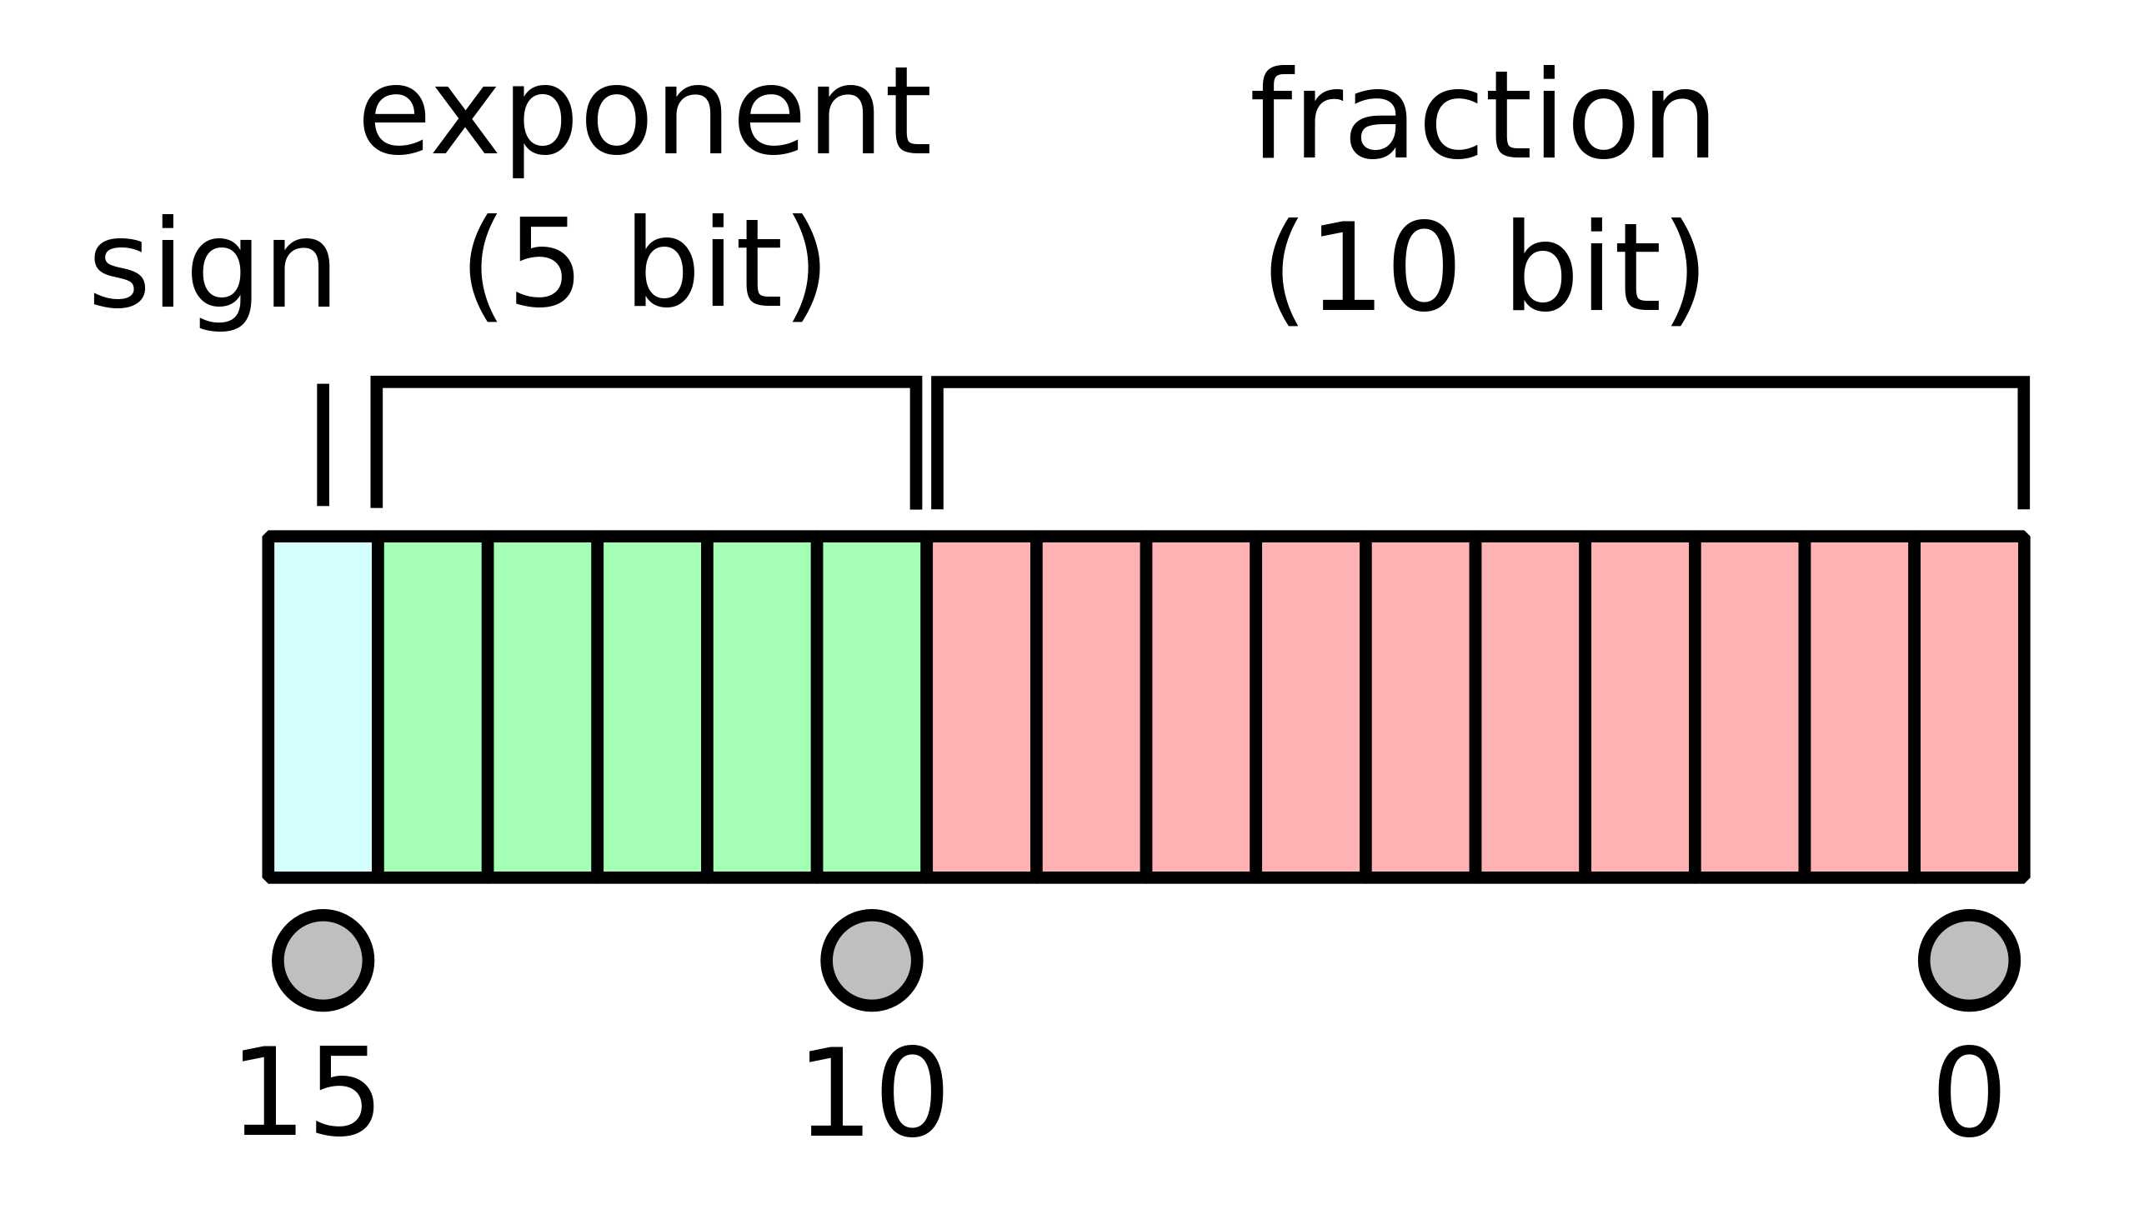
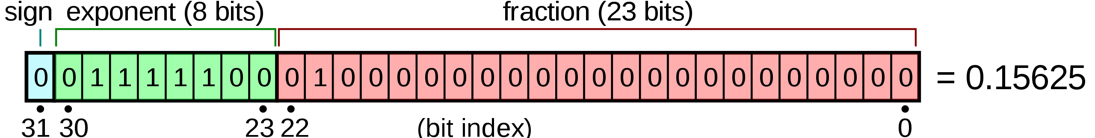
Fp32 and FP16
FP32
8-bit exponent, 23-bit mantissa Dynamic range: 1.4 x 10⁻⁴⁵ < x < 3.4 x 10³⁸
FP16
5-bit exponent, 10-bit mantissa Dynamic range: 5.96 x 10⁻⁸ < x < 65504
Notes:
Specify dynamic range. Why use different datatypes in different places? Different precisions are best suited to different ops,
And there’s a benefit for doing the right ops in the right precision. Why/when would you use fp32 Example Why/when would you use fp16? Faster training Int8 Fast inference with quantized models

Slide 7
Maximizing model performance
FP16 is fast and memory-efficient.
FP32
FP16 with Tensor Cores
1x compute throughput
1x memory throughput
1x memory storage
8X compute throughput
2X memory throughput
1/2X memory storage

Slide 8
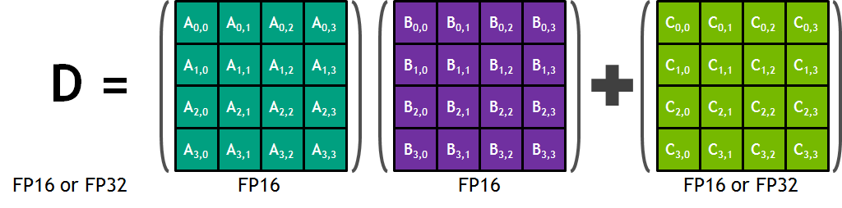
Maximizing model performance
FP16 input enables Volta/Turing Tensor Cores.
FP16 Input, FP32 Accumulate, FP16 Output for GEMMs and Convolutions
125 TFlops Throughput: 8X more than FP32 on Volta V100

Slide 9
Maximizing model performance
FP32 offers precision and range benefits.
FP32
FP16
Wider dynamic range
Increased precision captures small accumulations
Narrower dynamic range
Reduced precision may lose small accumulations

Slide 10
Maximizing model performance
Certain ops require FP32 dynamic range.
Reductions, exponentiation
a = torch.cuda.HalfTensor(4096) a.fill_(16.0)
a.sum()
inf
b = torch.cuda.FloatTensor(4096) b.fill_(16.0)
b.sum()
65,536
Notes:
Certain other ops internal to the network can also benefit from the wider precision of FP32. Batchnorm is a good example, also softmax, exponentiation, logarithms, and reductions.
Above is a simple example where a sum is shown to overflow in FP16 but easily captured by FP32. For GTC: Batchnorm example instead, showing precision loss instead of a hard inf

Slide 11
Maximizing model performance
Addition of large + small values benefits from FP32 precision.
Weight updates, reductions again
1 + 0.0001 = ??
param = torch.cuda.HalfTensor([1.0]) update = torch.cuda.HalfTensor([.0001])
print(param + update)
1
In FP16, when update/param < 2⁻¹¹ ≈ 0.00049, update has no effect.
param = torch.cuda.FloatTensor([1.0]) update = torch.cuda.FloatTensor([.0001])
print(param + update)
1.0001
Notes:
FP32 helps if your function is numerically sensitive to its inputs, and also if your function produces outputs outside the dynamic range of FP16, and if you’re accumulating

Slide 12
Maximizing model performance
Assign each operation its optimal precision.
FP16
GEMMs + Convolutions can use Tensor Cores
Most pointwise ops (e.g. add, multiply): 1/2X memory storage for intermediates, 2X memory throughput
FP32
Weight updates benefit from precision
Loss functions (often reductions) benefit from precision and range
Softmax, norms, some other ops benefit from precision and range
ReLU
GEMM
Softmax
Loss
Notes:
Certain other ops internal to the network can also benefit from the wider precision of FP32. Batchnorm is a good example, also softmax, exponentiation, logarithms, and reductions.
Above is a simple example where a sum is shown to overflow in FP16 but easily captured by FP32. For GTC: Batchnorm example instead, showing precision loss instead of a hard inf

Slide 13
Mixed precision in practice: Speed
Single Volta, FP32 vs Mixed Precision
Nvidia Sentiment Analysis**: 4.5X speedup
** https://github.com/NVIDIA/sentiment-discovery
Notes:
Certain other ops internal to the network can also benefit from the wider precision of FP32. Batchnorm is a good example, also softmax, exponentiation, logarithms, and reductions.
Above is a simple example where a sum is shown to overflow in FP16 but easily captured by FP32. For GTC: Batchnorm example instead, showing precision loss instead of a hard inf

Slide 14
Mixed precision in practice: Speed
Single Volta, FP32 vs Mixed Precision
Nvidia Sentiment Analysis**: 4.5X speedup FAIRseq: 4X speedup
** https://github.com/NVIDIA/sentiment-discovery
Notes:
Certain other ops internal to the network can also benefit from the wider precision of FP32. Batchnorm is a good example, also softmax, exponentiation, logarithms, and reductions.
Above is a simple example where a sum is shown to overflow in FP16 but easily captured by FP32. For GTC: Batchnorm example instead, showing precision loss instead of a hard inf

Slide 15
Mixed precision in practice: Speed
Single Volta, FP32 vs Mixed Precision
Nvidia Sentiment Analysis**: 4.5X speedup FAIRseq: 4X speedup GNMT: 2X speedup
** https://github.com/NVIDIA/sentiment-discovery
Notes:
Certain other ops internal to the network can also benefit from the wider precision of FP32. Batchnorm is a good example, also softmax, exponentiation, logarithms, and reductions.
Above is a simple example where a sum is shown to overflow in FP16 but easily captured by FP32. For GTC: Batchnorm example instead, showing precision loss instead of a hard inf

Slide 16
Mixed precision in practice: accuracy
Same accuracy as FP32, with no hyperparameter changes.
Model | FP32 | Mixed Precision**
AlexNet | 56.77% | 56.93%
VGG-D | 65.40% | 65.43%
GoogLeNet (Inception v1) | 68.33% | 68.43%
Inception v2 | 70.03% | 70.02%
Inception v3 | 73.85% | 74.13%
Resnet50 | 75.92% | 76.04%
ILSVRC12 classification top-1 accuracy. (Sharan Narang, Paulius Micikevicius et al., "Mixed Precision Training“, ICLR 2018)
**Same hyperparameters and learning rate schedule as FP32.
Notes:
Even though a copy of the weights in FP32 may be kept, the memory usage of a neural network during training is dominated by saved activations, which are represented in FP16, so the memory reduction is still considerable and comparable.

Slide 17
Amp for pytorch

Slide 18
AmP: automatic mixed precision
Existing FP32 (default) script -> Add 2 lines of Python -> Accelerate your training with mixed precision

Slide 19
example
N, D_in, D_out = 64, 1024, 512
x = torch.randn(N, D_in, device=“cuda”)
y = torch.randn(N, D_out, device=“cuda”)
model = torch.nn.Linear(D_in, D_out).cuda()
optimizer = torch.optim.SGD(model.parameters(), lr=1e-3)
for t in range(500):
y_pred = model(x)
loss = torch.nn.functional.mse_loss(y_pred, y)
optimizer.zero_grad()
loss.backward()
optimizer.step()
Notes:
A simple familiar example, linear layer.

Slide 20
example
N, D_in, D_out = 64, 1024, 512
x = torch.randn(N, D_in, device=“cuda”)
y = torch.randn(N, D_out, device=“cuda”)
model = torch.nn.Linear(D_in, D_out).cuda()
optimizer = torch.optim.SGD(model.parameters(), lr=1e-3)
model, optimizer = amp.initialize(model, optimizer, opt_level=“O1”)
for t in range(500):
y_pred = model(x)
loss = torch.nn.functional.mse_loss(y_pred, y)
optimizer.zero_grad()
with amp.scale_loss(loss, optimizer) as scaled_loss:
scaled_loss.backward()
optimizer.step()
Notes:
This is really the most important slide in the talk. These three lines are the necessary-and-sufficient interface that enable Amp to implement mixed precision for you. In previous talks, we’ve described mixed precision implementations that required writing additional user code to manage master weights, loss scaling, function type preservation, etc, but with this interface, my intention is that you don’t have to change any user code aside from these three lines. This interface also enables you to experiment with different mixed precision options, which I’ll describe in more detail shortly, just by changing individual flags. Note that you never have to call .half() on your model or data manually.

Slide 21
Amp.initialize()
Sets up your model(s) and optimizer(s) for mixed precision training.
model, optimizer = amp.initialize(model, optimizer,
opt_level, cast_model_type=None, patch_torch_functions=None, keep_batchnorm_fp32=None, master_weights=None, loss_scale = None)
Required. Establishes a default set of under-the-hood properties that govern the chosen mode.
Optional property overrides, for finer-grained control

Slide 22
Optimization levels
opt_level=“O0”
O1
FP32 training.
Your incoming model should be FP32 already, so this is likely a no-op. O0 can be useful to establish an accuracy baseline.
Mixed Precision.
Patches Torch functions to internally carry out Tensor Core-friendly ops in FP16, and ops that benefit from additional precision in FP32. Also uses dynamic loss scaling. Because casts occur in functions, model weights remain FP32.
O2
O3
“Almost FP16” Mixed Precision.
FP16 model and data with FP32 batchnorm, FP32 master weights, and dynamic loss scaling. Model weights, except batchnorm weights, are cast to FP16.
FP16 training.
O3 can be useful to establish the “speed of light” for your model. If your model uses batch normalization, add keep_batchnorm_fp32=True, which enables cudnn batchnorm.
Notes:
Next 1-2 slides: Show graph(s) with results of various opt-levels on Imagenet example

Slide 23
No manual casts needed
N, D_in, D_out = 64, 1024, 512
x = torch.randn(N, D_in, device=“cuda”)
y = torch.randn(N, D_out, device=“cuda”)
model = torch.nn.Linear(D_in, D_out).cuda()
optimizer = torch.optim.SGD(model.parameters(), lr=1e-3)
model, optimizer = amp.initialize(model, optimizer, opt_level=“O1”)
for t in range(500):
y_pred = model(x)
loss = torch.nn.functional.mse_loss(y_pred, y)
optimizer.zero_grad()
with amp.scale_loss(loss, optimizer) as scaled_loss:
scaled_loss.backward()
optimizer.step()
No need to manually cast your
model or data, regardless of
opt_level
No need to manually cast your output or target, regardless of opt_level
Notes:
Let amp implement the recipe This is really the most important slide in the talk. These three lines are the necessary-and-sufficient interface that enable Amp to implement mixed precision for you. In previous talks, we’ve described mixed precision implementations that required writing additional user code to manage master weights, loss scaling, function type preservation, etc, but with this interface, my intention is that you don’t have to change any user code aside from these three lines. This interface also enables you to experiment with different mixed precision options, which I’ll describe in more detail shortly, just by changing individual flags. Note that you never have to call .half() on your model or data manually.

Slide 24
optimization levels in action
https://github.com/NVIDIA/apex/tree/master/examples/imagenet
Mixed Precision (O1 and O2)
2X faster than FP32
Only ~6% overhead relative to “speed of light”
Timings on NVIDIA Volta V100 32GB On 8 Voltas, O0 converged to 76.15%, O1 converged to 76.38%, O2 converged to 75.9%
Notes:
Converge them out on dbcluster and include accuracy numbers

Slide 25
Mixed precision guidance
O0 (FP32) first to establish an accuracy baseline.
Try O1 to enable mixed precision.
For the adventurous, try O2 or O3, which may improve speed.
Experiment! The AMP API makes it easy to try different mixed precision modes and properties.
Notes:
No cost, lots of potential benefit. For retraining, once a baseline is established, you may discover that mixed precision receives the same accuracy in half the time or less.

Slide 26
Mixed precision principles in amp
Notes:
Add slide showing cases where FP32 is needed: Sensitive to inputs, dynamic range, accumulation

Slide 27
Mixed precision training principles
Accumulate in FP32.
Represent values in the appropriate dynamic range.
Notes:
No cost, lots of potential benefit. For retraining, once a baseline is established, you may discover that mixed precision receives the same accuracy in half the time or less.

Slide 28
FP32 weights
Weight updates are an accumulation.
1 + 0.0001 = ??
param = torch.cuda.HalfTensor([1.0]) update = torch.cuda.HalfTensor([.0001])
print(param + update)
1
In FP16, when update/param < 2⁻¹¹ ≈ 0.00049, update has no effect.
param = torch.cuda.FloatTensor([1.0]) update = torch.cuda.FloatTensor([.0001])
print(param + update)
1.0001
Notes:
At this point you might be asking yourself “why not do everything in FP16?” Where does the “mixed” in mixed precision come from? The answer is that sometimes you can just do everything in FP16, but there are certain ops that benefit from the precision of FP32, and leaving them in FP32 can improve accuracy and stability in end-to-end training. One of these is weight updates. Due to FP32 having more mantissa bits, it is able to capture and retain smaller weight updates, which can be beneficial later in training, when you’re close to convergence and the gradient values are small in magnitude relative to the values of the params or weights themselves. An example is shown above

Slide 29
Mixed precision training principles
Accumulate in FP32. AMP maintains weights in FP32.
Represent values in the appropriate dynamic range.
Notes:
No cost, lots of potential benefit. For retraining, once a baseline is established, you may discover that mixed precision receives the same accuracy in half the time or less.

Slide 30
Gradient underflow
Small gradients may underflow in FP16 regions of the network.
MODEL
FP16 Dynamic Range
FP16 Layers
Loss
FP32 Dynamic Range
Gradients
FP16 gradients underflow to zero
Notes:
There’s one final trick that’s helpful when all or part of your network is FP16, which doesn’t necessarily involve FP32 conversions, but is still an important part of mixed precision training. Late in training when gradients are small in magnitude, FP16 gradients may underflow to zero. Loss scaling is a simple trick that increases the magnitude of the gradients as they flow through the network, preserving them in the FP16 representable range. You can see the control flow above. You need to unscale the gradients before calling optimizer.step(), to be consistent with your learning rate. Because gradients are unscaled, the loss scale is orthogonal to the learning rate, and we find that using loss scaling or changing the loss scale does not require retuning other hyperparameters.
For GTC Add references slide

Slide 31
Loss scaling
Scaling the loss brings gradients into the FP16 dynamic range.
MODEL
Scaled Loss
FP16 Dynamic Range
FP16 Layers
FP32 Dynamic Range
Scaled
Gradients
Notes:
There’s one final trick that’s helpful when all or part of your network is FP16, which doesn’t necessarily involve FP32 conversions, but is still an important part of mixed precision training. Late in training when gradients are small in magnitude, FP16 gradients may underflow to zero. Loss scaling is a simple trick that increases the magnitude of the gradients as they flow through the network, preserving them in the FP16 representable range. You can see the control flow above. You need to unscale the gradients before calling optimizer.step(), to be consistent with your learning rate. Because gradients are unscaled, the loss scale is orthogonal to the learning rate, and we find that using loss scaling or changing the loss scale does not require retuning other hyperparameters.
For GTC Add references slide

Slide 32
Loss scaling
Scaling the loss brings gradients into the FP16 dynamic range.
MODEL
Scaled Loss
FP16 Dynamic Range
FP16 Layers
FP32 Dynamic Range
Scaled
Gradients
Unscale gradients in FP32
for optimizer.step()
Notes:
There’s one final trick that’s helpful when all or part of your network is FP16, which doesn’t necessarily involve FP32 conversions, but is still an important part of mixed precision training. Late in training when gradients are small in magnitude, FP16 gradients may underflow to zero. Loss scaling is a simple trick that increases the magnitude of the gradients as they flow through the network, preserving them in the FP16 representable range. You can see the control flow above. You need to unscale the gradients before calling optimizer.step(), to be consistent with your learning rate. Because gradients are unscaled, the loss scale is orthogonal to the learning rate, and we find that using loss scaling or changing the loss scale does not require retuning other hyperparameters.
For GTC Add references slide

Slide 33
Loss scaling
Scaling the loss brings gradients into the FP16 dynamic range.
Multiply the loss by some constant S. scaled_loss = loss*S
scaled_loss.backward() By the chain rule, gradients will also be scaled by S. This preserves small gradient values.
Unscale gradients before optimizer.step().**
** Unscaling ensures loss scaling does not affect the learning rate. Loss scaling does not require retuning the learning rate.
Notes:
There’s one final trick that’s helpful when all or part of your network is FP16, which doesn’t necessarily involve FP32 conversions, but is still an important part of mixed precision training. Late in training when gradients are small in magnitude, FP16 gradients may underflow to zero. Loss scaling is a simple trick that increases the magnitude of the gradients as they flow through the network, preserving them in the FP16 representable range. You can see the control flow above. You need to unscale the gradients before calling optimizer.step(), to be consistent with your learning rate. Because gradients are unscaled, the loss scale is orthogonal to the learning rate, and we find that using loss scaling or changing the loss scale does not require retuning other hyperparameters.
For GTC Add references slide

Slide 34
Mixed precision training principles
Accumulate in FP32. AMP maintains weights in FP32.
Represent values in the appropriate dynamic range. AMP scales the network’s gradients.
Notes:
No cost, lots of potential benefit. For retraining, once a baseline is established, you may discover that mixed precision receives the same accuracy in half the time or less.

Slide 35
Opt_levels and properties
Each opt_level establishes a set of properties:
cast_model_type (torch.dtype)
Cast your model’s parameters and buffers to the desired type.
patch_torch_functions (True or False)
Patch all Torch functions to perform Tensor Core-friendly ops in FP16, and any ops that benefit from FP32 precision in FP32.
keep_batchnorm_fp32 (True or False)
Maintain batchnorms in the desired type (typically torch.float32).
master_weights (True or False)
Maintain FP32 master weights for any FP16 model weights (applies to opt_level=“O2”).
loss_scale (float, or “dynamic”) If loss_scale is a float value, use this value as the static (fixed) loss scale. Otherwise,
automatically adjust the loss scale as needed.

Slide 36
Opt_levels and properties
o0
O1
FP32 training.
Your incoming model should be FP32 already, so this is likely a no-op. O0 can be useful to establish an accuracy baseline.
cast_model_type=torch.float32 patch_torch_functions=False keep_batchnorm_fp32=None** master_weights=False loss_scale=1.0
** None indicates “not applicable.”
Mixed Precision.
Patches Torch functions to internally carry out Tensor Core-friendly ops in FP16, and ops that benefit from additional precision in FP32. Also uses dynamic loss scaling. Because casts occur in functions, model weights remain FP32.
cast_model_type=None patch_torch_functions=True keep_batchnorm_fp32=None master_weights=None** loss_scale=“dynamic”
** Separate FP32 master weights are not applicable because the weights remain FP32.

Slide 37
O1 (Patch_torch_Functions)
Patches torch.* functions to cast their inputs to the optimal type.
Ops that are fast and stable on Tensor Cores (GEMMs and Convolutions) run in FP16. Ops that benefit from FP32 precision (softmax, exponentiation, pow) run in FP32.
Conceptual operation of patching:
for func in fp16_cast_list: def create_casting_func(old_func):
def func_with_fp16_cast(input):
return old_func(input.half()) return func_with_cast
torch.func = create_casting_func(torch.func)
for func in fp32_cast_list: def create_casting_func(old_func):
def func_with_fp32_cast(input):
return old_func(input.half()) return func_with_cast
torch.func = create_casting_func(torch.func)
model, optim = amp.initialize(model, optim,
opt_level=“O1”)

Slide 38
Opt_levels and properties
o2
O3
“Almost FP16” Mixed Precision. FP16 model and data with FP32 batchnorm, FP32 master weights, and dynamic loss scaling. Model weights, except batchnorm weights, are cast to FP16.
cast_model_type=torch.float16 patch_torch_functions=False keep_batchnorm_fp32=True master_weights=True loss_scale=“dynamic”
FP16 training.
O3 can be useful to establish the “speed of light” for your model. If your model uses batch normalization, add the manual override keep_batchnorm_fp32=True, which enables cudnn batchnorm.
cast_model_type=torch.float16 patch_torch_functions=False keep_batchnorm_fp32=False master_weights=False loss_scale=1.0

Slide 39
Opt_levels and properties
Properties for a given opt_level can be individually overridden.
model, optimizer = amp.initialize(model, optimizer,
opt_level=“O1”, loss_scale=128.0)
Sets up loss_scale=“dynamic” by default.
Optional override: Tells Amp to use a static loss scale of 128.0 instead.

Slide 40
Opt_levels and properties
Properties for a given opt_level can be individually overridden.
model, optimizer = amp.initialize(model, optimizer,
opt_level=“O1”, loss_scale=128.0)
Sets up loss_scale=“dynamic” by default.
Optional override: Tells AMP to use a static loss scale of 128.0 instead.
AMP will issue a warning and explanation if you attempt to override a property that does not make sense. For example, setting opt_level=“O1” and the override master_weights=True does not make sense.

Slide 41
Example revisited
N, D_in, D_out = 64, 1024, 512
x = torch.randn(N, D_in, device=“cuda”)
y = torch.randn(N, D_out, device=“cuda”)
model = torch.nn.Linear(D_in, D_out).cuda()
optimizer = torch.optim.SGD(model.parameters(), lr=1e-3)
model, optimizer = amp.initialize(model, optimizer, opt_level=“O1”)
for t in range(500):
y_pred = model(x)
loss = torch.nn.functional.mse_loss(y_pred, y)
optimizer.zero_grad()
with amp.scale_loss(loss, optimizer) as scaled_loss:
scaled_loss.backward()
optimizer.step()

Slide 42
Amp operation summary
AMP casts weights and/or patches Torch functions based on opt_level and properties: model, optimizer = amp.initialize(model, optimizer, opt_level=“O1”)
AMP applies loss scaling as appropriate for the opt_level and properties:
with amp.scale_loss(loss, optimizer) as scaled_loss: scaled_loss.backward()
Notes:
Reiterate: You adhere to this simple API, there’s no cost to including Amp, and lots of potential benefit.

Slide 43
Try amp
Available through the NVIDIA Apex repository of mixed precision and distributed tools: https://github.com/nvidia/apex
Full API documentation: https://nvidia.github.io/apex/
For more on mixed precision, don’t forget to see: Myle Ott and Sergey Edunov, Taking Advantage of Mixed Precision to Accelerate Training Using PyTorch, GTC 2019 Session 9832 Right after this talk in Room 210D
Carl Case, Mixed Precision Training of Deep Neural Networks, GTC 2019 Session 9143

Slide 44
Tensor core performance tips

Slide 45
Tensor core Performance tips
GEMMs = “generalized (dense) matrix-matrix multiplies”: For A x B where A has size (M, K) and B has size (K, N): N, M, K should be multiples of 8.
GEMMs in fully connected layers: Batch size, input features, output features should be multiples of 8.
GEMMs in RNNs: Batch size, hidden size, embedding size, and dictionary size should be multiples of 8.
Libraries (cuDNN, cuBLAS) are optimized for Tensor Cores.

Slide 46
Tensor core Performance tips
How can I make sure Tensor Cores were used? Run one iteration with nvprof, and look for “884” kernels:
import torch
import torch.nn
bsz, in, out = 256, 1024, 2048
tensor = torch.randn(bsz, in).cuda().half()
layer = torch.nn.Linear(in, out).cuda().half()
layer(tensor)
Running with
$ nvprof python test.py
...
37.024us 1 37.024us 37.024us 37.024us volta_fp16_s884gemm_fp16…

Slide 47
Tensor core Performance tips
If your data/layer sizes are constant each iteration, try
import torch
torch.backends.cudnn.benchmark = True
...
This enables Pytorch’s autotuner. The first iteration, it will test different cuDNN algorithms for each new convolution size it sees, and cache the fastest choice to use in later iterations.
See https://discuss.pytorch.org/t/what-does-torch-backends-cudnn-benchmark-do/5936

Slide 49
Ensuring FP32 weight updates
optimizer = torch.optim.SGD(model.parameters()) model, optimizer = amp.initialize(model, optimizer, opt_level=“O2”)
After casting requested by O2, model may contain a mixture of fp16 and fp32 params.
model
param_0 (fp16)
param_1 (fp32)
param_2 (fp16)
optimizer references point to model params.
optimizer

Slide 50
Ensuring FP32 weight updates
optimizer = torch.optim.SGD(model.parameters()) model, optimizer = amp.initialize(model, optimizer, opt_level=“O2”)
model
param_0 (fp16)
param_1 (fp32)
param_2 (fp16)
AMP
With O2, AMP maintains FP32 master params for any FP16 params Patches optimizer’s references to point to master params. optimizer.step() acts on
master params.
master_0
master_2
optimizer

